Slide 1
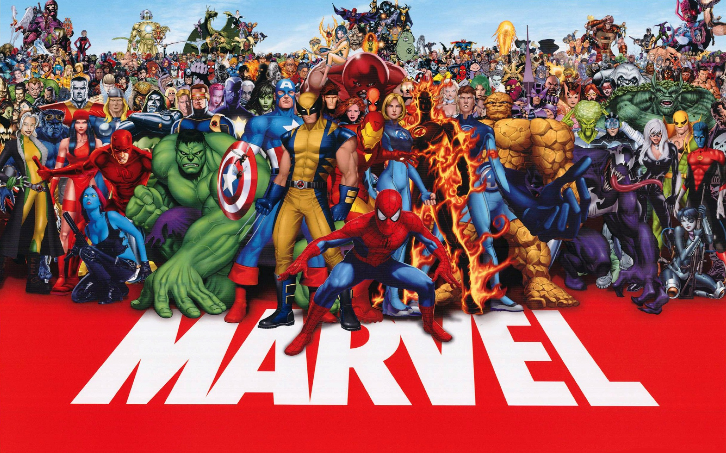
Bad ass | Green | Sticky | X-men
Smart ass | Big | Red | Massacre
Great ass | Strong | Web | Claws
Justice | Indestructible | Newspaper | Healer
Deadpool | Hulk | Spiderman | Wolverine
Super Heroes
A1
B1
C1
D1
A2
B2
C2
D2
A3
B3
C3
D3
A4
B4
C4
D4
A
B
C
D
SOLUTION

